Slide 1
Cloud Day Dublin
DUBLIN | 10.10.2024

Slide 2
Why you should build your next product with AppSync
COM290
Marco Troisi
CTO
Trilo

Slide 3
Hello there!
- Marco Troisi
- Born in Italy, living in the UK
- CTO at Trilo
- Software Developer and Software Architect for over 12 years
- AWS Community Builder (Serverless)
- Writer for The Serverless Mindset newsletter

Slide 4
Agenda
The evolution of AppSync
Reason #1: Rapid Prototyping
Reason #2: Infinite Scalability
Reason #3: Team Collaboration
Reason #4: Native AWS Integration
Reason #5: Error Reduction
Reason #6: Cloud-Native Evolution
Reason #7: Empowering Small Teams

Slide 5
The evolution of AppSync
- The building blocks
- Schema
- Data sources
- Resolvers

Slide 6
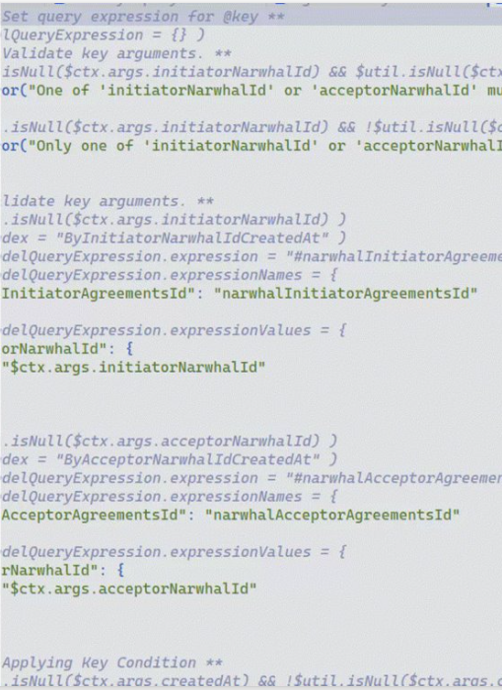
The evolution of AppSync
- The old AppSync
- VT-*hell*
- Not so great DX
- Business logic very hard to test

Slide 7
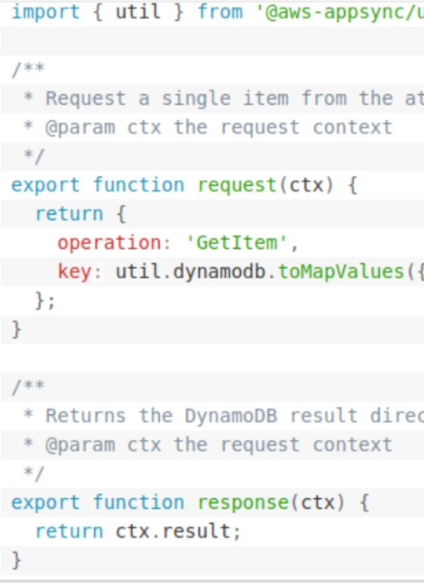
The evolution of AppSync
- The new AppSync
- Javascript resolvers
- Lambda resolvers
- More direct connections

Slide 8
Rapid prototyping
1. Build a UI
2. Write the interactions in GraphQL
3. Figure out the AWS services needed
4. Write the resolvers
5. Amplify codegen
6. Good to go 🎉

Slide 9
Infinite scalability
- Automatic scaling
- 100% serverless
- Real-time data sync
- IAM authentication
- Multi-region support

Slide 10
Team collaboration
- GraphQL as a shared language between frontend and backend
- Reduce misunderstandings
- Parallelise work

Slide 11
Native AWS integrations
- Easy to connect directly to AWS services
- No need for glue code

Slide 12
Error reduction
- Less reliance on custom code
- Fewer potential points of failure
- Less boilerplate

Slide 13
Cloud-native evolution
- The convenience of Django, Rails, Laravel (not really, but kinda)
- Backed by the cloud!
(AppSync is not a battery-included framework)

Slide 14
Empowering small teams
- We rebuilt our entire API layer in a few weeks
- Made us much more productive and able to parallelise our work
- Has given us clarity over our data access patterns
- Has made it easier for frontend people to venture into the backend

Slide 15
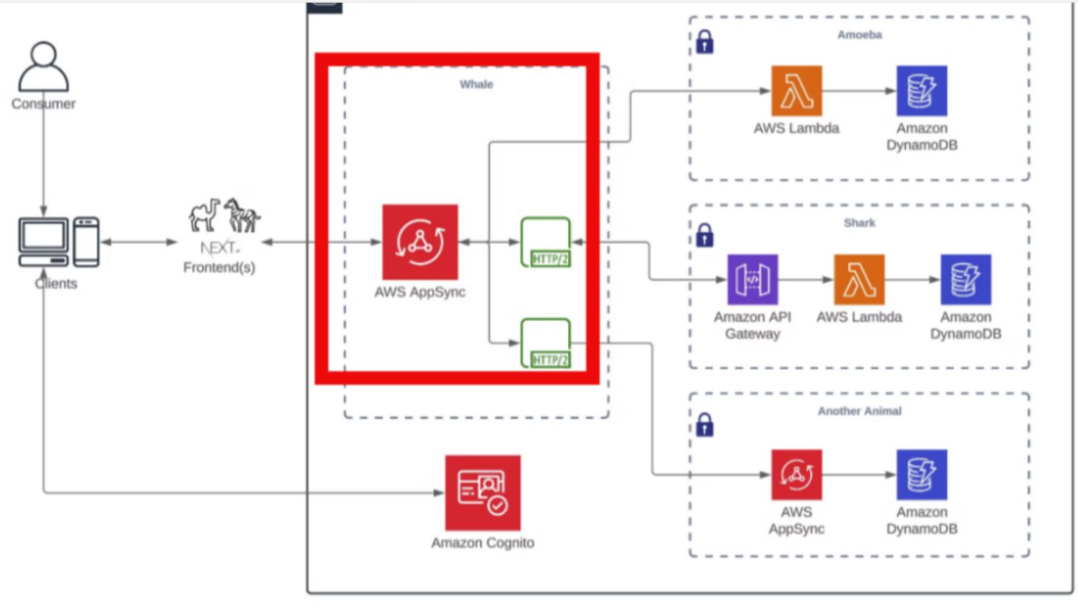

Slide 16
- Reason #1: Rapid Prototyping
- Reason #2: Infinite Scalability
- Reason #3: Team Collaboration
- Reason #4: Native AWS Integration
- Reason #5: Error Reduction
- Reason #6: Cloud-Native Evolution
- Reason #7: Empowering Small Teams

Slide 17



Marco Troisi
marco@trilo.io
@marcotroisi
marcotroisi

Slide 19
Examples of how to use the template layouts

Slide 20
Presentation slide examples for reference
ABC229-S
Sponsored by anycompany
Ana Carolina Silva (she/her)
Alejandro Rosalez (he/him)
Senior Solutions Architect
AnyCompany
Principal Engineer
Example Corp.

Slide 21
Agenda
Where we were
Our roadmap to the solution
Key steps we took and decisions we made
How we solved the problem
Where we are today

Slide 22

Good presentations
Are customer-focused
Are true to the abstract
Tell a story
Provide clear takeaways
Have simple visuals and one message per slide

Slide 23
Every new thing creates two new questions and two new opportunities.
Jeff Bezos
Founder and Executive Chair of Amazon

Slide 24
Tables
USE ONE OF THESE preformatted TABLES AS A STARTING POINT OR MODEL FOR YOUR TABLE
 | Tables | Charts
Main use | Focus on data points | Focus on trends or relationships
Main benefit | Precise | Visual
Second benefit | Drill down on specific data | Simplify complex datasets
Data tips | Table tips | Table formatting | Table don’ts
Be honest and precise | Remove clutter | Left align | Don’t use tiny text
Make a point | Emphasize message | Use consistent sizes | Don’t include it all
Use the right method | Keep it short | Use visible colors | Don’t overcomplicate

Slide 25
Charts
To create a new chart, select Insert tab > Chart. Enter your data and adjust the font sizes to the minimum 12 pt. or larger.
Use a bright color to emphasize the most important data. Use subtle colors for other data.

Slide 26
Demo

Slide 27





Additional resources
Generate QR codes AWS speakers only
Microsoft PowerPoint Help & Learning site Essential basics on using PowerPoint from Microsoft
The World of Presentations podcast Conversations with industry experts about PowerPoint design, mechanics, and presenting
BrightCarbon events Free webinars on PowerPoint design, presenter skills, and more
AWS speakers, more resources are on the wiki

Slide 28

Ana Carolina Silva
Alejandro Rosalez
@anacarolinasilva
alejandrorosalez (GitHub)

Slide 29
How to use this event template

Slide 30
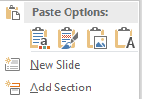
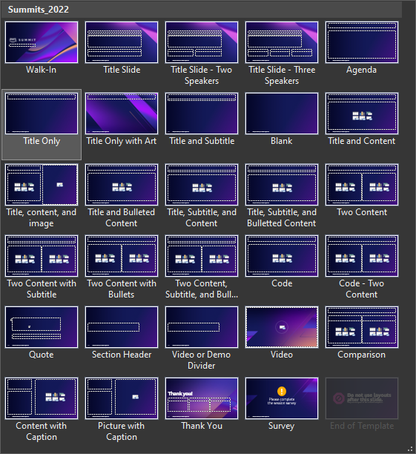
How to add or reuse content
Follow these steps to use this template to create a new slide deck:
Enter your content on the blank slides and delete any unneeded or hidden slides.
If you want to add more slides, on the Insert tab, select the little arrow under New Slide, and then select your desired layout from the options displayed (shown below). Fill out your slide content using the preformatted context placeholders.
End the deck with the Thank You slide and then the Survey Reminder slide layouts.
Follow these steps to apply this template to your existing slide deck:
Select all of the slides in the left-hand pane of this template file and delete them (click on one and press Ctrl + A and then Delete).
Open the deck you’ve already created and select all of the slides in the left-hand pane (Ctrl + A) and copy them (Ctrl + C).
In the template file, right-click in the empty left-hand pane and click Use Destination Theme (use this same method to transfer individual slides).
For each slide in your deck, apply the appropriate layout (Home tab > Slides section > Layout).
Reset the slides (Home tab > Slides section > Reset) and ensure all content is in the appropriate placeholders and resets to the correct location. If needed, copy-paste the content into the correct placeholders.
Save the file and create/revise content as described to the left.
29 available slide layouts

Slide 31

Font guidance
Font family
Only use the Amazon Ember font family (with the exception of code, which should use Lucida Console).
Use Amazon Ember Heavy for titles, sentence case (sentence-style capitalization).
Use Amazon Ember for slide text, sentence case.
Font styling
Do not underline text that is not a hyperlink.
Use font sizes that are at least 20 pt. for slide text and at least 12 pt. for diagrams.
If using color for emphasis in text, use bold as well.
Do these fonts match?
Multiple Amazon EC2 instances
If not, contact the event manager for a font pack.

Slide 32
Visual accessibility guidelines
For visibility, use a minimum 20 pt for slide text and 12 pt for diagrams. For lines, use a minimum 1.5 pt line weight.
Color also affects visibility. Text (or lines) and the background should have a contrast ratio of at least 4.5:1. Generally, white or black on a strongly contrasting background is the best choice. This slide shows some color choices with good contrast and some color choices with poor contrast.
Avoid using color as a sole indicator of difference (for example, use labels in addition to color to differentiate lines).
Black text
21.0
11.3
7.4
6.4
Visible color combos
White text
21.0
19.9
8.8
4.9
Color text
11.3
8.8
7.4
4.8
2.4
2.8
3.3
1.9
Color combos to avoid
1.2
1.7
1.5
1.5
1.3
1.2
1.8
1.5
2.2
2.4
2.6
1.9

Slide 33
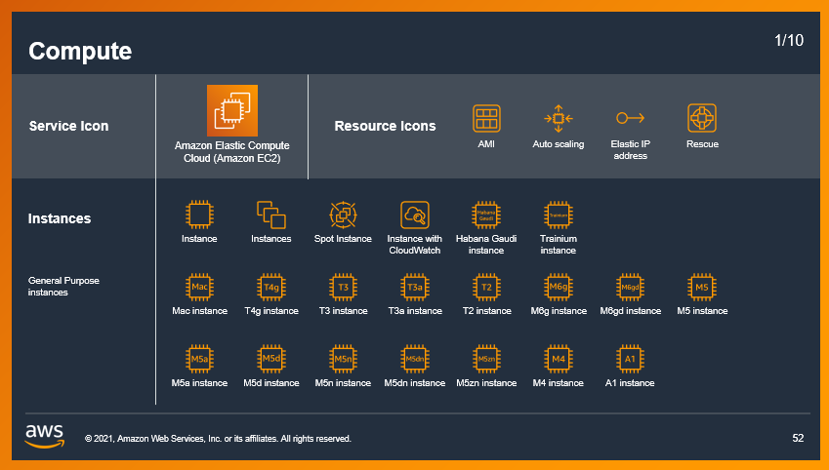

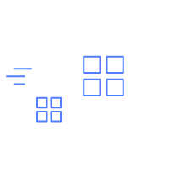

Icons, logos, diagrams, animations, and images
Only use logos, icons, photos, screenshots, and illustrations that your company has permission (a license) from the copyright owner to use.
Keep slide diagrams as simple as possible; split content over several slides rather than forcing it all onto one.
Use simple, subtle animations as needed to direct audience attention and clarify relationships. Avoid dramatic transitions or animations (such as “Random Bars,” “Dissolve,” or “Spin”).
Download AWS architecture icons from the AWS website
AWS speakers, download illustrations, icons, and AWS logos from the brand portal
AWS speakers, find licensed stock photography on Amazon Freeway or request access to Adobe Stock

